Slide 1
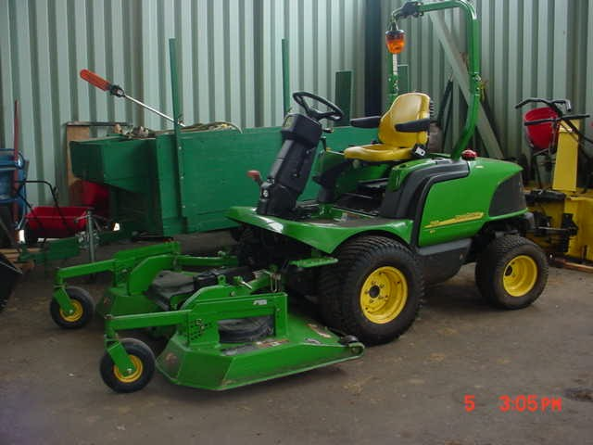
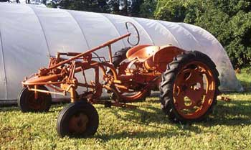
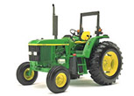
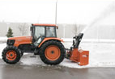
WSU TRACTOR SAFETY
EH&SS 4/07/REDING

Slide 2
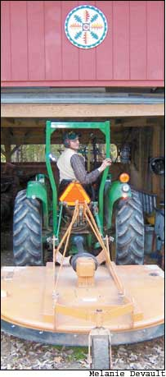
PRESENTATION WILL COVER
Tractor Operation Basics
Common Tractor Hazards
Accident Prevention
Rollover Protection Structures (ROPS)

Slide 3
TRACTORS: FRIEND & FOE
Tractors are often considered a farmer’s best friend. Yet, tractors continue to cause serious injury and death among users & ground workers.
Even though tractor hazards have been identified for years, the same injuries/accidents continue to occur, even though there are known engineering controls and standard procedures to deal with these hazards.
Few of the recorded tractor injury accidents have been caused by equipment failure-
MOST ARE CAUSED DIRECTLY OR INDIRECTLY BY OPERATOR ERROR OFTEN INVOLVING CARELESSNESS, BAD JUDGEMENT OR UNNECESSARY HURRY

Slide 4
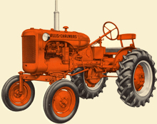
AGE OF THE TRACTOR
Newer tractors have many safety controls that automatically protect the user
Our state-wide tractor fleet contains many older tractors
Knowledge gap exists for younger workforce and new hires of any age on how to operate tractors safely (esp. older models)
Training tractor drivers on each tractor
and its implements is essential

Slide 5
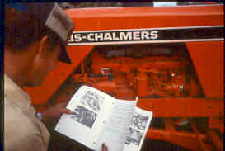
TRACTOR OPERATOR MANUALS
Tractor and tractor implement operator’s manuals are the “oracle” on proper tractor operation & maintenance
As many of WSU tractors are older, manuals are sometimes lost. If manuals aren’t on-site, find a copy:
  Contact manufacturer
  Internet search

Slide 6
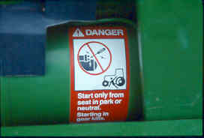
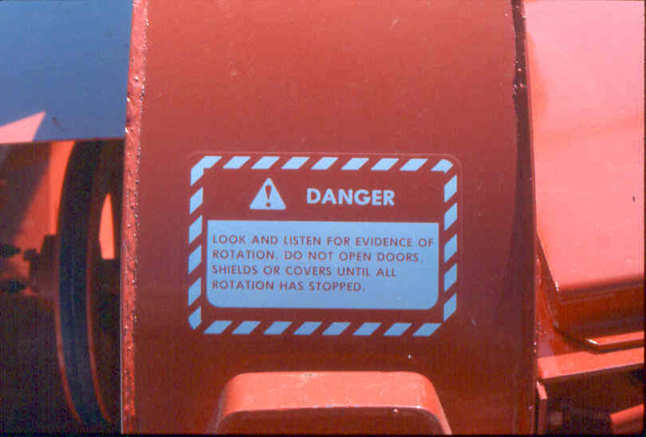
POSTED INSTRUCTIONS & LABELS
Heed tractor labels

Slide 7
EMPLOYER’ RESPONSIBILITIES
Provide employees with a properly maintained tractor
Provide safety features for the tractor
Provide operator training
Supervise and enforce responsible operation of equipment

Slide 8

WSU OPERATOR
PRE-QUALIFICATIONS
Equipment operators MUST
    be 18 and have a valid drivers license
    be trained on the specific tractor and implements they will be using prior to operating equipment

Slide 9

TRACTOR OPERATOR RESPONSIBILITIES
Stay alert and avoid potential hazards
Preview your route for obstacles, holes, slopes, ditches, terrain, etc. Remove debris
Maintain and use the tractor’s safety features (such as, ROPS, seat belt, & PTO shields)
Conduct tractor pre-operation checks
Operate the tractor and implements safely and according to manufacturer’s directions
Use the right tractor and implement for the job
Know equipment blind spots

Slide 10

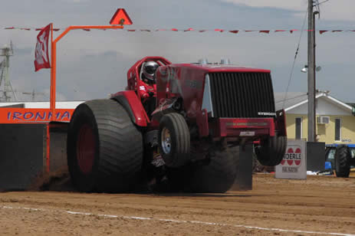
TRACTOR OPERATOR RESPONSIBILITIES
Use tractor as intended
  Slow down!
  No passengers!
  No horseplay!

Slide 11
TRACTOR OPERATOR RESPONSIBILITIES
Fuel tractor when engine is off and cool
Use tractor responsibly in enclosed spaces to avoid carbon monoxide poisoning
Never leave a tractor running unattended
Before dismounting switch off the engine and wait for the tractor and PTO implements to come to a complete stop
Take the tractor key with you!

Slide 12
TRAINING AN OPERATOR
Training should include classroom and field lessons on:
Tractor hazards and operational basics
Familiarization with equipment operator manuals and manual location
The importance of not operating equipment with mechanical problems or missing shields and other safety devices
Familiarization of terrain hazards where the tractor will be used including holes, obstacles, slopes, embankments, stumps, ditches, etc.
Hands-on operational instruction on tractor(s) and implement(s) to be used
Competency test drive for tractor and for implement attachment operation
Written training documentation

Slide 13

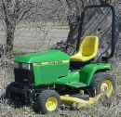
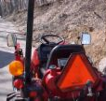

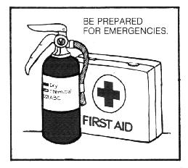
TRACTOR SAFETY FEATURES
PTO shield & other machine guards
ROPS
Seat belt
Rear view mirrors
Head/Tail/Turn/Warning Lights
Back-up alarm
Slow Vehicle Warning Triangle
Fire extinguisher
First Aid Kit

Slide 14
COMMON MISHAPS
Rollovers: rear and side
Front-end loader incidents
Falls from tractor
Tractor run-over's
Caught-between crushing
PTO shaft entanglement
By-pass starting

Slide 15
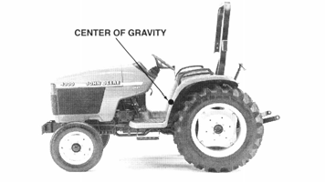
TRACTOR ROLLOVERS
Tractor rollovers happen when the center of gravity moves past a baseline of stability, either to the side or rear of the machine.
Many rollovers happen at speeds <8 mph and on slopes less than 5°. Avoid sudden motions.
Contributing factors to rollovers are:
Various sizes, shapes and weights of implements
Speed!!!
Terrain
Human error
Know the safe working load of each tractor & never exceed it!

Slide 16
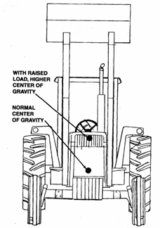
CENTER OF GRAVITY
Center of gravity affected by slopes, loads, turns & terrains
Stay Centered!
When the center of gravity is raised the risk of rollover increases

Slide 17
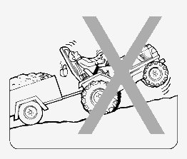
REARWARD ROLLOVERS
Common causes for rear-ward rollovers:
Tractor is stuck in mud or snow preventing rear wheels from rotating
Rear wheels can’t turn because of chains, boards, or other materials used to improve traction
Climbing a hill that is too steep
Clutch is released too quickly w/ transmission in a lower gear and engine at high speed
Load is too heavy and/or hitched above the drawbar of the tractor

Slide 18
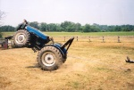
REARWARD ROLLOVERS
Usually caused by rear axle torque and/or drawbar leverage as tractors easily tip to the rear when the rear wheels can’t rotate enough to move the machine forward
Tractor can tip
in as little as
¾ of a second

Slide 19
PREVENTING REARWARD ROLLOVERS
Release clutch only when rear wheels can rotate forward
Do not climb steep hills in a forward direction. Instead, use a reverse gear to back the tractor up a the hill
Use only enough engine speed to start tractor moving while engaging the clutch smoothly
Change speed gradually by applying power smoothly
Ballast (counter-balance) the tractor properly for the job
Hitch loads properly to drawbar
Use reverse gear to break tractor tires free from frozen conditions
It is preferred to use another tractor to pull out a tractor from a ditch or muck. To avoid injury take care in using tire chains, boards, and other traction materials to improve tire traction

Slide 20
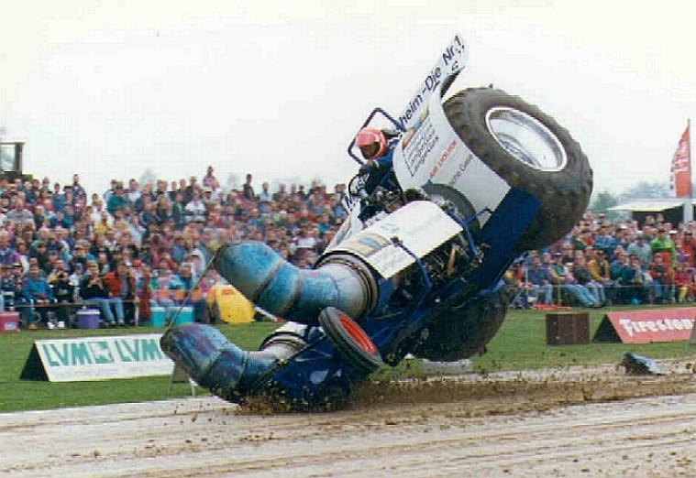
SIDEWAYS ROLLOVERS

Slide 21
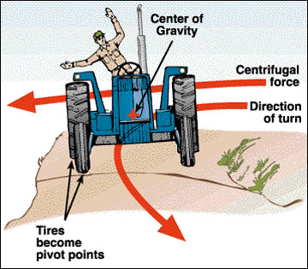
SIDEWAYS ROLLOVERS
Common causes for sideways rollovers are tractor:
Driven on hillside that is too steep
Driven too close to the edge of a roadside ditch or embankment
Cornering too sharply or too fast
(centrifugal force pivots tractor on
outside wheels)
The tractor’s front-end loader is
elevated too high on a hillside
or in a turn at excessive speed

Slide 22
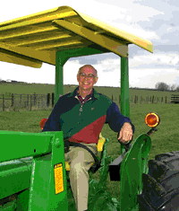
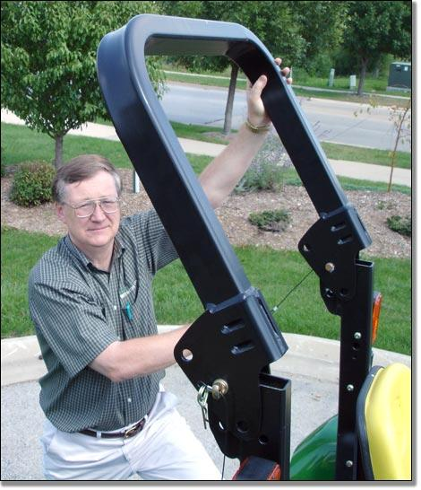
ROLLOVER PROTECTIVE STRUCTURES
R-O-P-S
Stationary
or
Foldable

Slide 23
ROLLOVER PROTECTIVE STRUCTURES
(ROPS)
ROPS work by limiting a rollover to 90° and preventing the operator from being crushed under the weight of the tractor
ROPS work only if the operator is wearing a seatbelt to keep them in the operator station as the tractor is rolling

Slide 24
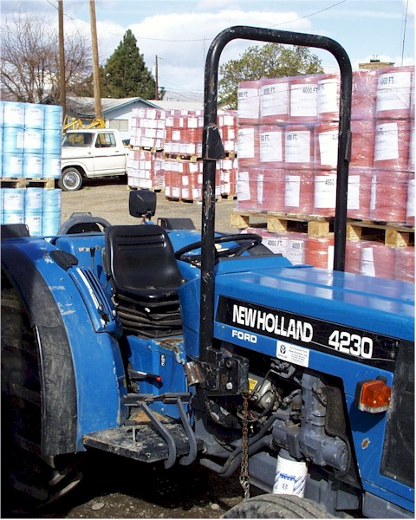
What is a Protective Zone?
An imaginary space surrounding an operator’s body
ROPS and a seatbelt keep the operator within this safe space in the event of a rollover
This is the Protective Zone

Slide 25
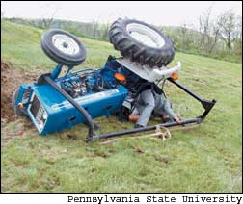
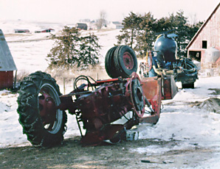
ROPS save lives!
SEATBELT
*No ROPS-cause for the majority tractor-related fatalities (~130/yr)!
*Runovers are second (fatalities ~ 60/yr)!

Slide 26
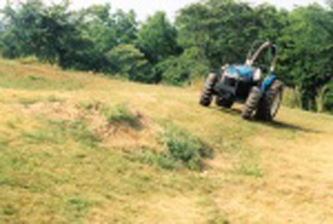
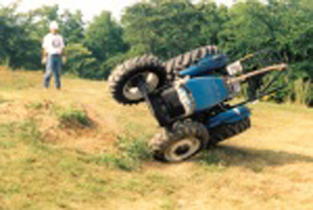
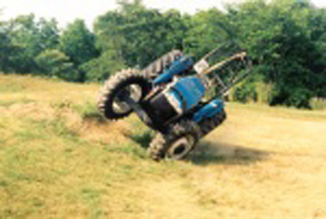
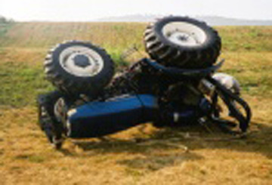
ROPS AND SIDEWAYS ROLLOVER DEMO
1
PAST POINT OF NO RETURN
3
TWO HILLSIDE DEPRESSIONS
2
4
TRACTOR HITS DEPRESSION & TIPS
ROPS & SEATBELT PROTECT OPERATOR

Slide 27
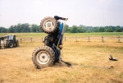
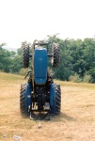
ROPS & REARWARD ROLLOVER
With ROPS & a seatbelt, operator has an excellent chance of being contained in the protective zone and surviving a rear rollover.

Slide 28
WHEN ARE ROPS REQUIRED BY LAW
WHEN:
Engine greater than 20 horsepower
Vehicle is 2-wheel, 4-wheel or track driven (crawler-type) and designed to pull, propel, or carry implements designed for agricultural use (disk, tiller, plow, etc.)
Manufactured after October 25, 1976
The manufacturer made a retrofit ROPS option available or it was available at the time tractor manufactured (no matter what year tractor manufactured)

Slide 29
ROLLOVER PROTECTIVE STRUCTURES (ROPS)
ROPS must come from the manufacturer and must not be made “on-the-job” or “home-made”
One limited exception to ROPS requirement is low profile tractors used under certain conditions (see following slides)

Slide 30
LOW PROFILE TRACTOR ROPS & INTENDED USE EXEMPTION
Low profile tractors do not require ROPS
when used in:
Orchards, vineyards, hop yards where ROPS would interfere with normal operations or related work
Farm buildings or greenhouse where vertical clearances are insufficient to allow ROPS
When tractor has mounted equipment that is incompatible with ROPS
THESE USES ARE THE ONLY EXCEPTIONS- LOW PROFILE TRACTORS ARE NOT TO BE USED FOR ANY OTHER PURPOSES

Slide 31
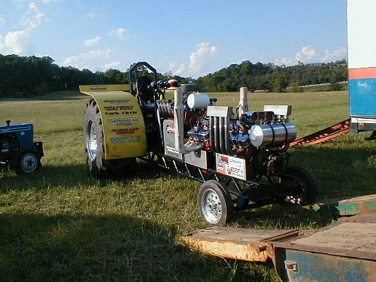
INTENDED USE MATTERS!
ROPS are required on this low-profile racing tractor!

Slide 32
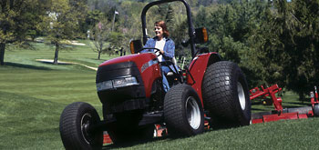
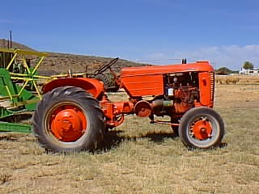
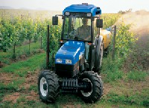
WHAT IS A LOW PROFILE TRACTOR?
Low-profile tractors:
Are wheeled
Have equal spacing between wheel centerlines of the two front and rear tires
Have clearance of 18” or less from bottom of tractor chassis to ground
Hood’s highest point is 60” or less from ground
Are designed so operator straddles the transmission when seated

Slide 33
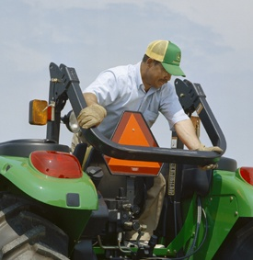
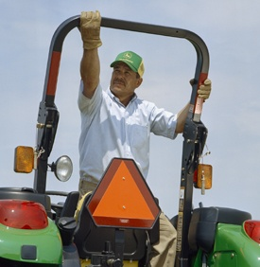
ROLLOVER PROTECTION
FOLDABLE ROPS
Foldable ROPS are available for some tractors
Fold down in low vertical clearance areas
Return ROPS to upright position as soon as possible after close clearance work is done
It is recommended to install foldable ROPS on low profile when available

Slide 34
ROLLOVER PREVENTION
OPERATING ON SLOPES
Avoid working on steep slopes
Follow operator manual instructions on operating equipment on slopes
Set wheels wide
Drive slowly
Make wide slow turns
Know the terrain: small holes, depressions, or stump can cause tip over
Stay back from embankment edges as they are often soft
Go down slope in low gear
Follow operator manual instructions on side mount implement placement (up or down hill)

Slide 35
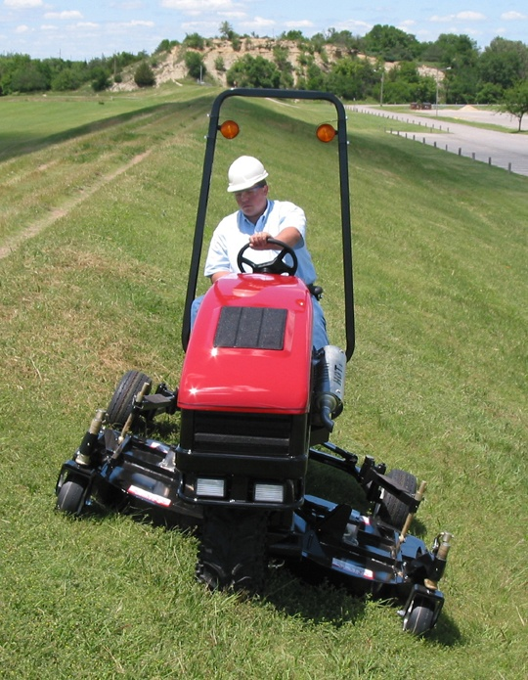
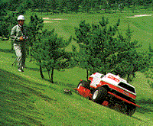
ROLLOVER PREVENTION
OPERATING ON SLOPES
Remote Control-Kubota
Harper-Deweze All Terrain Mower

Slide 36
ROLLOVER PREVENTION IMPROPER HITCHING
Hitch loads for pulling to the drawbar or the three-point hitch only
Use draw bar at height recommended in operator’s manual. Don’t alter or raise height of the drawbar. Raising the drawbar decreases safety & pulling effectiveness.
Install stay races where feasible to maintain a safe drawbar height
  Loads that are attached by looping a chain around the axle housing, seat base, or upper link of the 3-point hitch reduce the pulling capacity and increase the possibility of rear-ward rollover

Slide 37
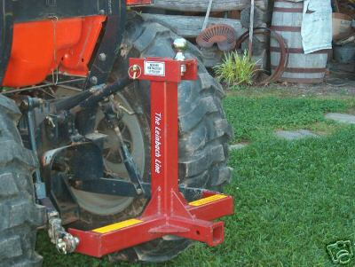
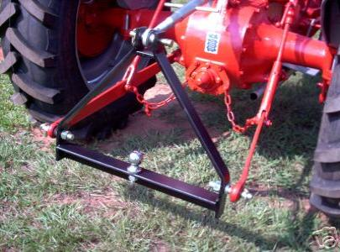
HITCHES
3-point hitch is desired
Always hitch to the drawbar

Slide 38
FRONT-END LOADER INCIDENTS
Front-end loaders are used for lifting & moving materials
Mishaps are caused by exceeding lifting capacity, lack of safety equipment, or inappropriate use including:
  Front-loader attachment not intended for lifting people
  Speed: working too fast for existing conditions
  Rear of tractor may not have proper counter balance for the load
  Weight of load: Exceeding front loader lift capacity

Slide 39
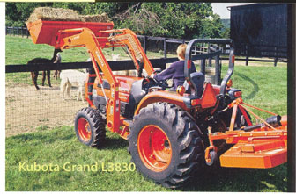
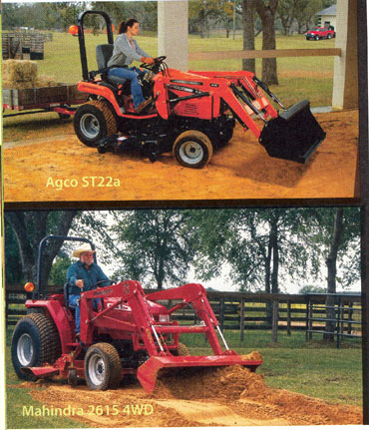
TRACTOR FRONT LOADER INCIDENTS
KEEP LOADS LOW!
  Lifting loads too high can cause instability, rollover, and injury
Remember center of gravity changes as bucket rises

Slide 40
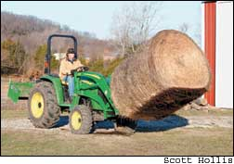
FRONT LOADER INCIDENTS
  Shape of load can cause instability
  Use proper tools to lift odd shapes
  Many injuries happen while hauling hay-this bale type can crush a driver or ground worker

Slide 41
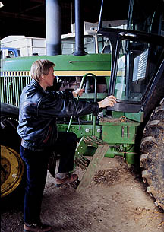
FALLS FROM TRACTORS
Most falls are due to improper mounting or dismounting of the tractor.
Injuries to wrist, arm, hip, leg, ankle & runovers can result
Don’t “jump” down from tractor
(WSU accident reports from several locations-ankles & feet)
Use a 3-point mount (either 2 hand and one foot or 2 feet and one hand in contact with steps at all times)
Face the tractor when going up and down the steps and use handholds. There is less chance of catching pant’s cuffs or boot loops on clutch pedal, etc. which can pitch a person off the tractor

Slide 42
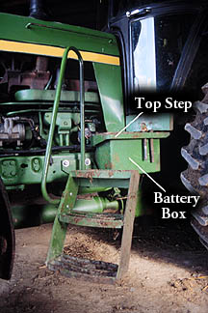
FALLS FROM TRACTORS
Beware slippery, wet, and muddy surfaces
Accident photo:
A person slipped on these muddy stairs and was run over and killed by this tractor

Slide 43
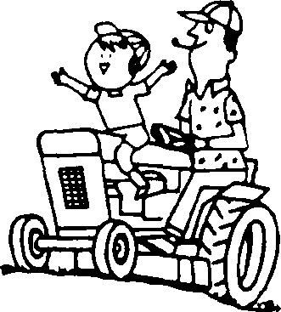

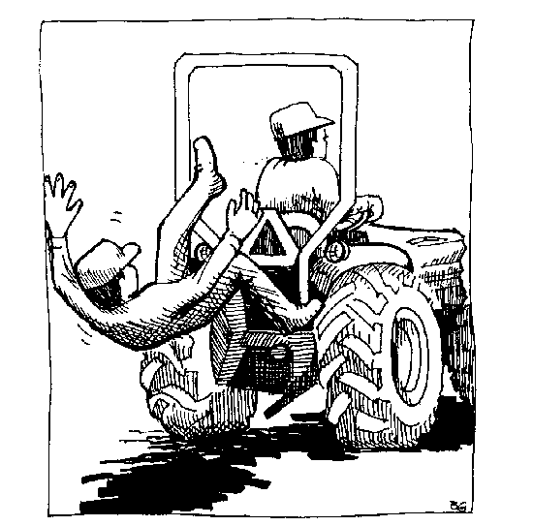
FALLS FROM TRACTOR
Most tractors are not designed to carry passengers
Maintain a no rider policy
Injury occurs to passengers by falling from tractor & being run over once they have fallen

Slide 44
RUNOVER INCIDENTS
Usually happens due to:
Inability to see small children or others in the line of travel
Extra riders falling off from steps, cab, or drawbar
Backing the tractor toward machinery to be attached
By-pass starting
Avoid runovers by:
Keeping speed down
Keeping others esp. children out of the area where a tractor is operating
Not allowing ground workers to enter area between tractor and implement until the tractor has been stopped, shifted into neutral and the brakes applied
Having ground workers step out of the area when adjustments have to be made between the tractor and implement
Clear communication methods between operator and ground workers

Slide 45
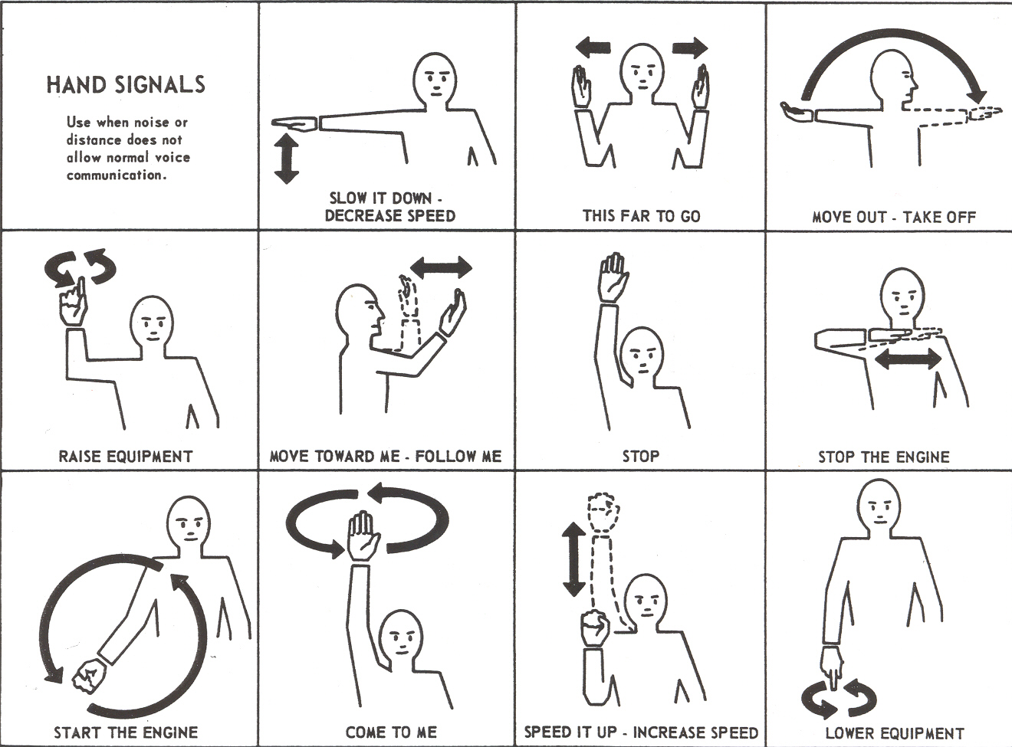
COMMUNICATION!
HAND SIGNALS for SAFETY

Slide 46
CAUGHT-BETWEEN INCIDENTS
“Caught between” means a ground worker is crushed between the tractor and an implement
This often occurs when the tractor is backing up to an implement to hook up
Common causes of caught-between accidents:
  Break down of communication between operator and person on the ground
  Loss of control of the tractor
  Worker in wrong spot
  Operator can’t see worker
  Operator misjudges and tractor moves rearward too far
  To avoid caught-between incidents refer to run over prevention procedures
To avoid caught-between incidents refer to run over prevention procedures

Slide 47
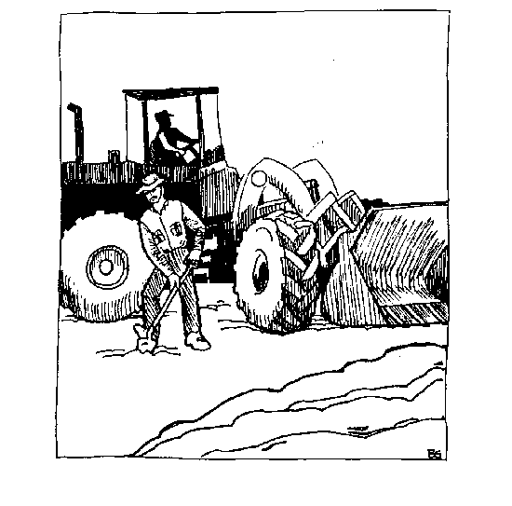
CAUGHT BETWEEN
ARTICULATING TRACTOR INCIDENTS
There is potential to crush a person on either side of the tractor in the area between the front and rear wheels
Stay out of this danger area as much as possible
  Slight movement of steering wheel causes tractor to articulate in the middle bringing the front and rear wheels of one side or the other closer together
  If steering wheel is moved, even with engine not running, the tractor may articulate upon start-up

Slide 48
BY-PASS STARTING
CAUSES RUNOVER ACCIDENTS
By-pass starting is an unsafe practice of starting a tractor while standing on the ground and can result in the person being run over by the tractor
Starting the tractor from the ground is accomplished by rigging unsafe electrical connections or reaching up & over the tractor from the ground to turn ignition key (on older tractors)
New tractors are sold with shield covering the starter. Retro-fits can be gotten for some older tractors
Dead man’s seat switch is also a built-in safety factor. No one on seat, the tractor shuts off or won’t start

Slide 49
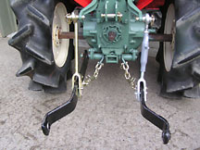

THE PTO (POWER TAKE-OFF)
PTO produces a rotating torque and directly transfers it to another machine or tool. For a mower implement the rotating torque is used to turn the mower blades

Slide 50

PTO ENTANGLEMENT INCIDENTS
The most gruesome of injuries resulting in severe injury, dismemberment, or death by the human body becoming entangled in (literally wrapped around) equipment
A PTO operating at 1000 rpm will pull in clothing at a rate of 8’ per second.
PTO powered implements operating at 540 rpm can entangle a shirt sleeve or pant leg around the drive shaft 9 times in 1 second dragging your arm or leg with it
Happens in a blink of an eye!

Slide 51

PTO GUARDS HELP PREVENT INJURY
PTO GUARDS HELP PREVENT INJURY

Slide 52

PTO ENTANGLEMENT
Proven accident prevention is to keep PTO shaft shields in place, and never remove them except for maintenance work.
While the tractor is off, always
inspect shaft, driveline & universal joint to ensure guarding prior to use.
Spin driveline guard to
ensure it is not stuck to
the shaft.
This does happen
Click to see an actual recent incident report

Slide 53
SIX COMMON MACHINE HAZARDS
Wrap points (hay baler, PTO shaft, auger)
Hydraulic systems (high pressure 1000-3000psi. Hot! Hoses can whip around; equipment fails and can crush)
Pinch points (gears, sprockets, moving parts of belt or pulley drives/chains)
Shear & cutting points (sickle bars, rotary blades grain augers)
Crush points (between two machinery parts or machines)
Thrown objects (ejected or propelled objects, stones, sticks, chaff, etc.)

Slide 54



SAFETY PRECAUTIONS AROUND MACHINERY
Field work is tiring
and
tired people make mistakes:
Beware of carelessness, impatience and fatigue
Tie back long hair
Do not wear loose clothing or jewelry
Wear eye, hearing, & foot protection
Prior to use assure all covers, shields & guards are in place
Never step across rotating mechanical parts
Keep extremities clear of operating parts. Work at least 12’ away when PTO is engaged (rule of thumb: 2x your height)
Never walk or stand behind operating farm machinery
Always de-energize equipment & wait for it to stop moving before performing adjustments, unclogging or service

Slide 55



SAFE OPERATION OF TRACTORS ON THE HIGHWAY
Attach a slow moving vehicle emblem.
Use headlights, flashing lights, safety clearance flags.
Use an escort vehicle when feasible.
Secure attachments in the transport position. Never operate attachments in transit.
Keep PTO level in neutral.
Don’t travel on the shoulder-soft spots.
Take it slow and pull over when feasible to let normal traffic pass.
Take special care at intersections, turns, & curves.
Always leave room to stop safely.
Independent brakes must be locked.
together to avoid uneven braking in
panic stop situations
Watch for blind spots.
Have a cell phone with you.
Carry instructions to your site.
  (contact info)

Slide 56



PPE (Personal Protective Equipment)
Depending on the situation, wear some or all of the following:
Hearing protection for prolonged noise exposure (plugs or muffs)
Gloves that fit and are the right type for the job can help guard against cuts, abrasions, skin irritants and chemicals
Long pants protect against flying debris, skin
irritants, and burns from exhaust
Respirators prevent inhalation of dust and other particulates, and most pesticide vapors
Eye protection- impact-resistant and UV
Sturdy work shoes (steel toes preferred)

Slide 57
RECAP
Use the right tractor and implement for the job
Conduct pre-operation checks
Maintain tractor safety features (esp. ROPS, seat belt, & PTO shields)
Operate the tractor and implements safely (consult operator’s manual)
Know equipment blind spots
Stay alert and avoid potential hazards-preview or know your route, obstacles, and terrain
Fuel when engine is cool; and never when engine is running

Slide 58
RECAP
Use the tractor as intended No passengers!
No horseplay!
Slow down! Speed kills
Never leave a tractor running unattended!
Before dismounting switch off the engine and wait for the tractor and PTO implements to come to a complete stop
Take the tractor key with you!

Slide 59

THINK SAFETY! ~ ACT SAFELY!
To Complete this training,
PROCEED TO TRACTOR QUIZ

Slide 60
THINK SAFETY! ~ ACT SAFELY!
To complete this training,
push the arrow to
PROCEED TO TRACTOR QUIZ

